Slide 1



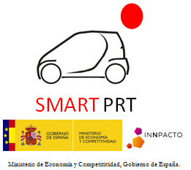

TWO INITIATIVES ON AUTONOMOUS VEHICLES AT MIRAMON TECHNOLOGY PARK (Citymobil2 & PRT MIRAMÓN)
Jesus Murgoitio¹
Maria Izaguirre²
(1) Tecnalia Research & Innovation
(2) Novadays
1st MOVESMART Workshop
Renewable Mobility Services in Smart Cities:
Challenges, Approaches and Social Aspects
15th October 2015

Slide 2
  Index
  MIRAMÓN: “Test Site”
  PRT MIRAMÓN:
    Project summary
    Objectives
    Demo & Vehicle (Video)
  CityMobil2:
    Project summary
    Objectives
    Demo & Vehicle
    Next actions
  Conclusions
2

Slide 3
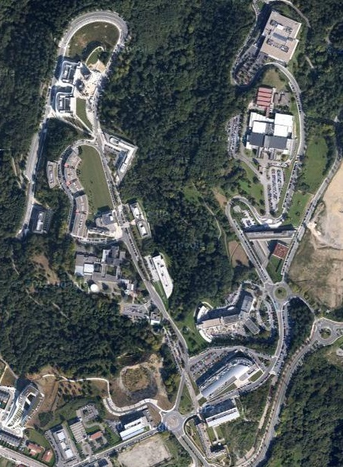
  Miramón: “Test Site”
  82 companies & research centers
  3.633 employers (R+D+i = 41%)
  581.509 m2
  36 tracks & 29 buildings
  Usual drivers: 67%
  Occupants per vehicle: 1,2
  Mobility due to job, health, studies and leisure
3

Slide 4
  Miramón: “Test Site”
  Adaptations for the current infrastructures:
    New traffic signals (speed limit = 30 Km/h, No parking, etc…)
    Painting of the road, red lines for pedestrian crossings.
    Separate road lanes & Traffic control.
    Ticketing integration between ARTS and public transport in San Sebastian.
    Installation of the static information about ARTS: maps and information about bus stops.
    Awareness campaign about advantages and disadvantages of ARTS.
4

Slide 5
  Miramón: “Test Site”
  Support received from many relevant institutions:
    Miramón Technology park.
    Regional government.
    Municipality of San Sebastian.
    DBUS: Urban transport system.
    MLC: Cluster for Mobility and Logistic.
    Legacy: Authorities like DGT for plates, etc….
5

Slide 6
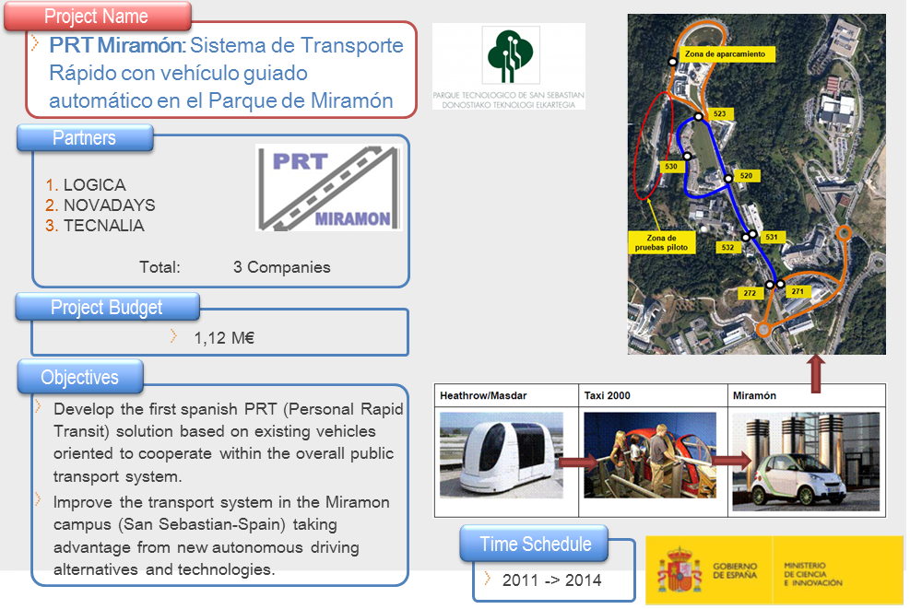

  PRT MIRAMON: Project summary
6

Slide 7
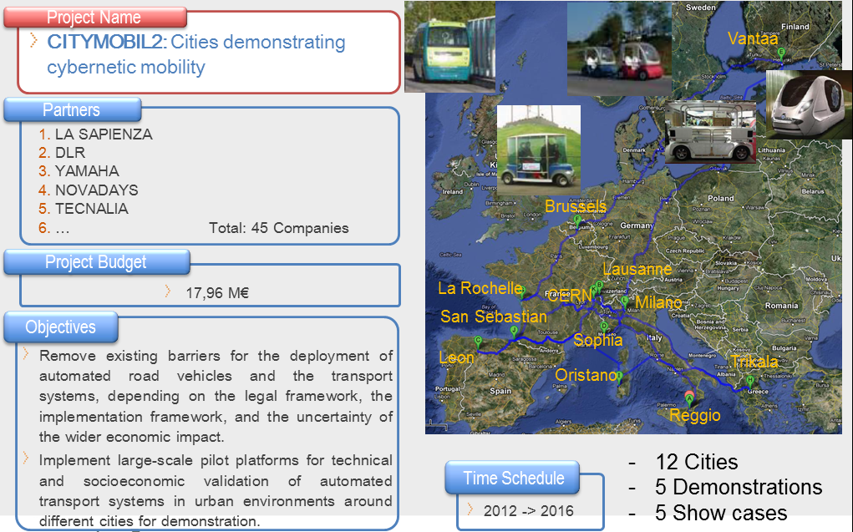
  CityMobil2: Project summary
7

Slide 8
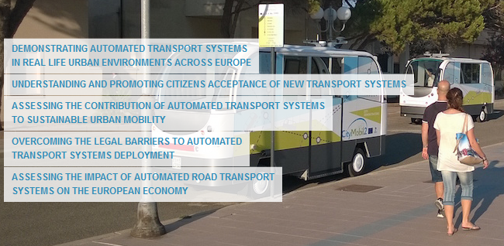
  CityMobil2: Objectives
8

Slide 9
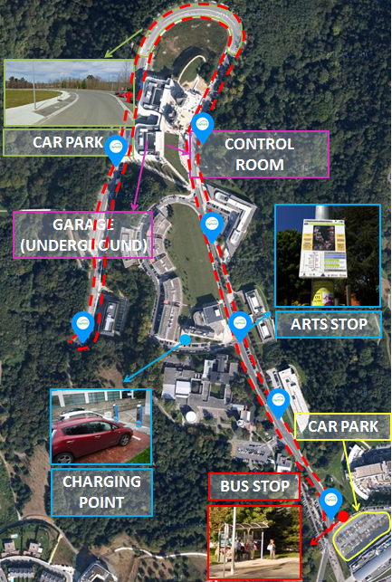
  Miramon: Demo
  System demonstration:
    From February to June 2016
    Total Distance (go & back): 3,6 km
    3 vehicles
    Mixed mode: On demand & frequency
    Garage underground
    Parking for vehicles
    Control Center & Charging points
    Bus stops for the ARTS
9

Slide 10
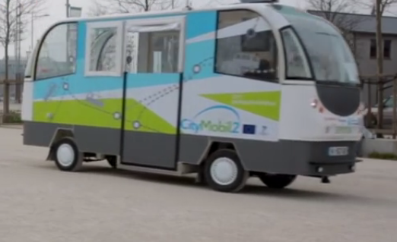
  CityMobil2: Vehicle
  3 vehicles
  Providers: Robosoft y Easymile
  Fully autonomous
  Capacity of the vehicles: 10-12 p.
  Maximum speed of the vehicles: 30 Km/h
  Electrics
  Preference to circulate against private vehicles.
10

Slide 11
  CityMobil2: Next actions
  Current Legislation: Permission if there is a co-pilot/vehicle.
  Local Legislation: min. and simple changes, (only annex to the local rules.
  Technical adaptations of the site.
  Awareness campaign.
  Find Co-financing
11

Slide 12
THANKS FOR YOUR ATTENTION
Jesús Murgoitio¹
María Izaguirre²
(1) Tecnalia Research & Innovation
(2) Novadays
1st MOVESMART Workshop
Renewable Mobility Services in Smart Cities:
Challenges, Approaches and Social Aspects
15th October 2015

